Slide 1

Design of a Decentralized Social Network
Author: Javier Hernández Sánchez
Tutor: Alejandro Antonio Alonso Muñoz

Slide 2

Table of content
Introduction to Social Media
The problems of centralized social media
Objectives and Requirements
Design of a decentralized social media
Development of a decentralized platform
Conclusions and results
Future lines

Slide 3

1. Introduction to
Social Media

Slide 4
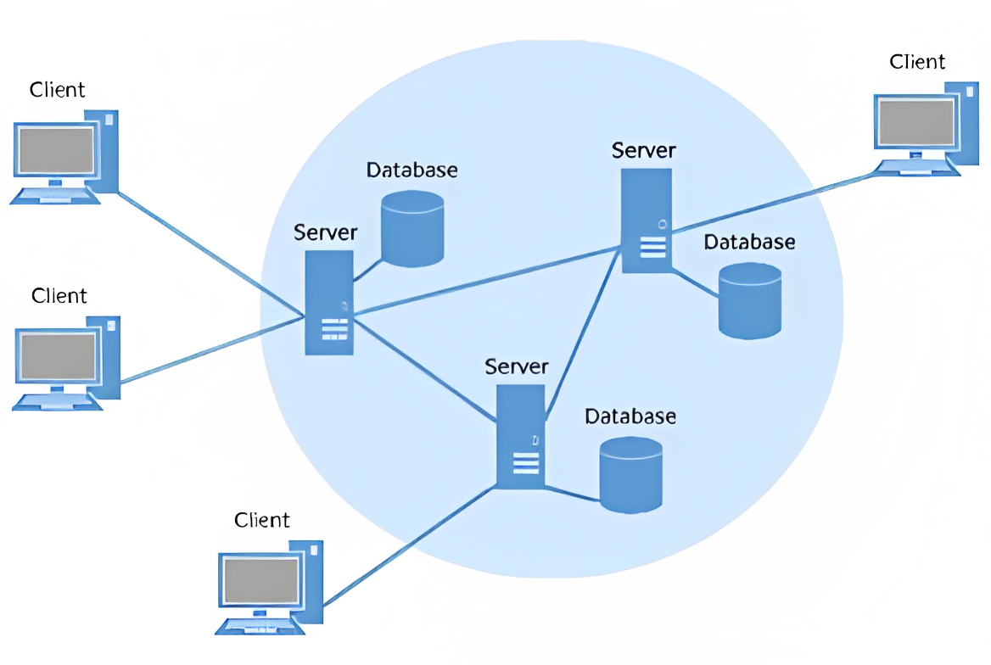

Slide 5

2. Problems of
centralized
Social Media

Slide 6
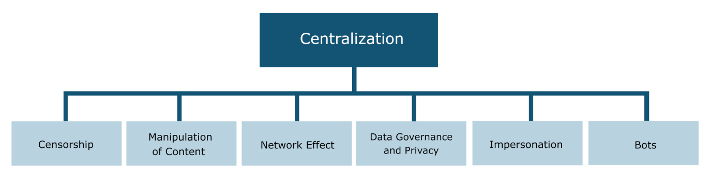

Slide 7

3. Objectives and requirements

Slide 8
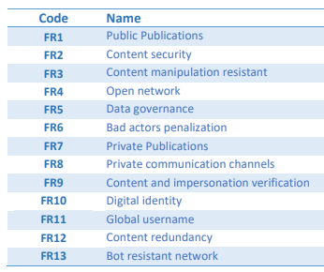
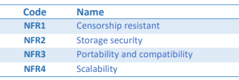
Objectives and Requirements
Main objective: Solve the problems of current centralized platforms.

Slide 9

4. Design of a decentralized social media

Slide 10
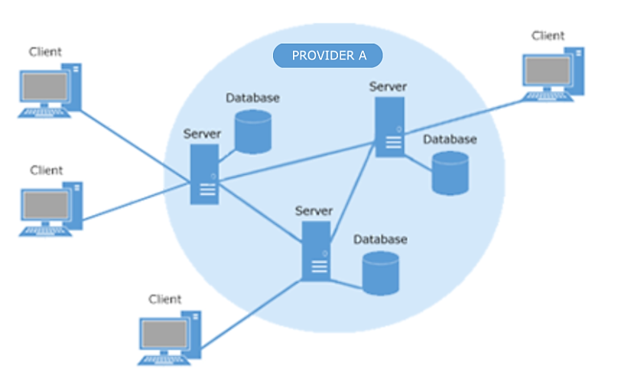
Distributed platform

Slide 11
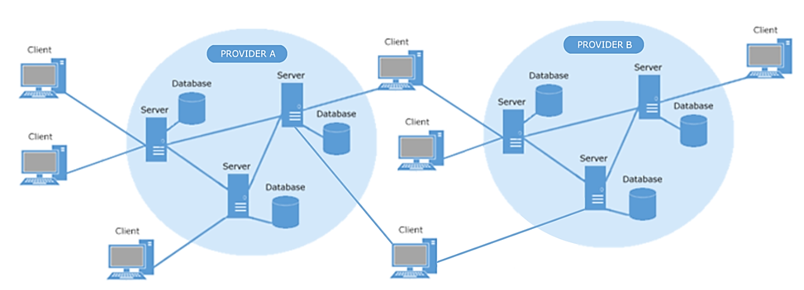
Decentralized platform

Slide 12
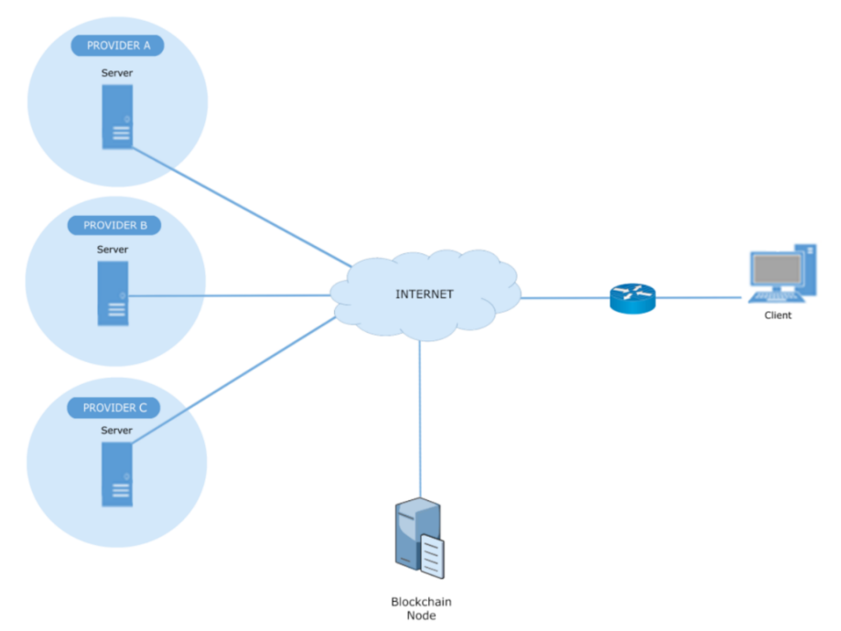
General architecture

Slide 13
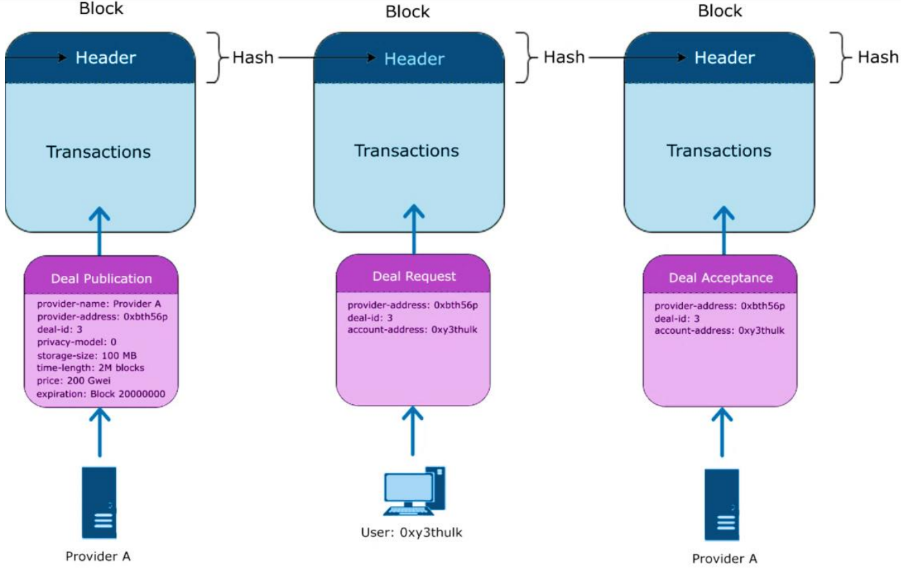
Provider selection

Slide 14
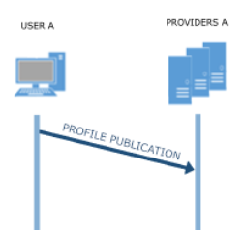
Profile Publication

Slide 15
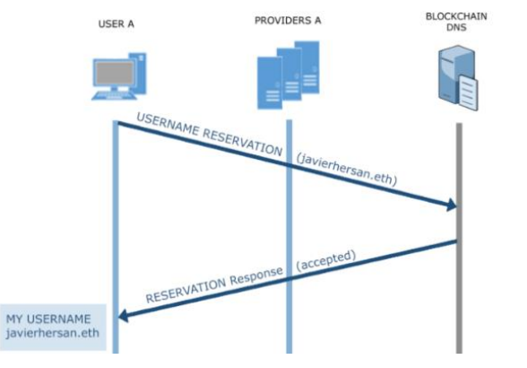
Username reservation and DNS

Slide 16
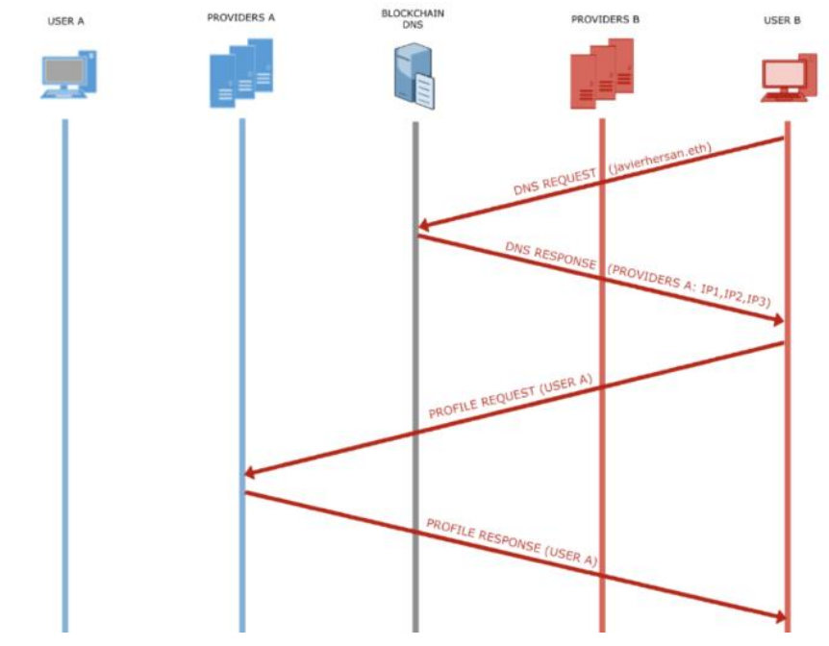
Profile Request

Slide 17

Network Interactions
Public publications
Private publications
Private communication channels between users
Deal system: users choose their providers.
Following and unfollowing accounts

Slide 18
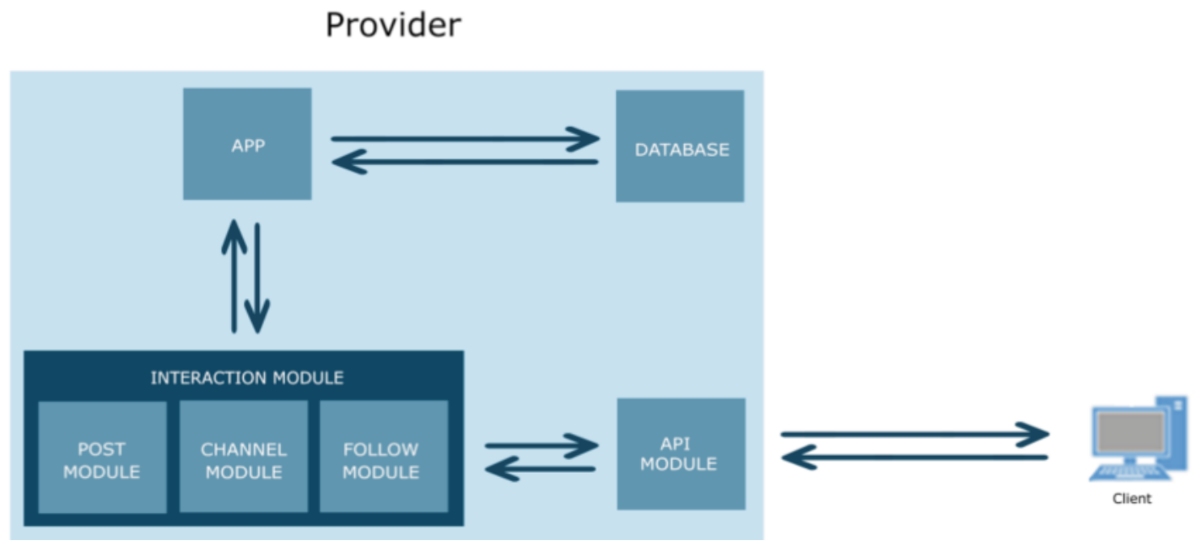
Server

Slide 19
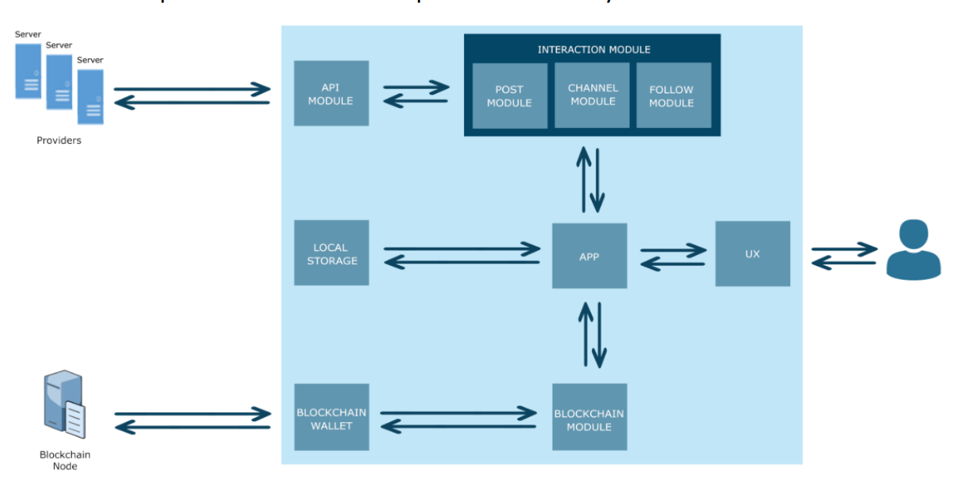
Client

Slide 20
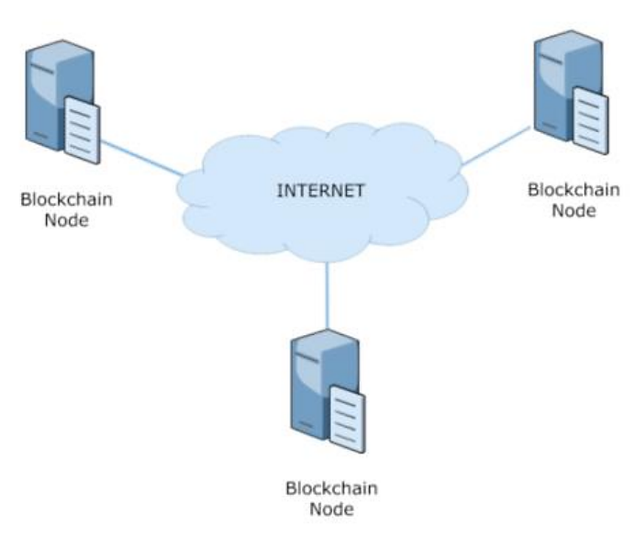
DNS

Slide 21
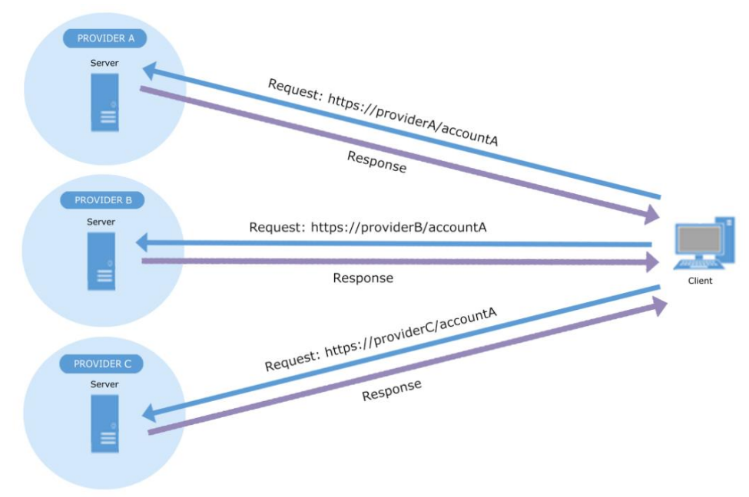
Interactions
Problems:
Impersonation: There is not self-sovereign digital identity
Inconsistency between providers

Slide 22
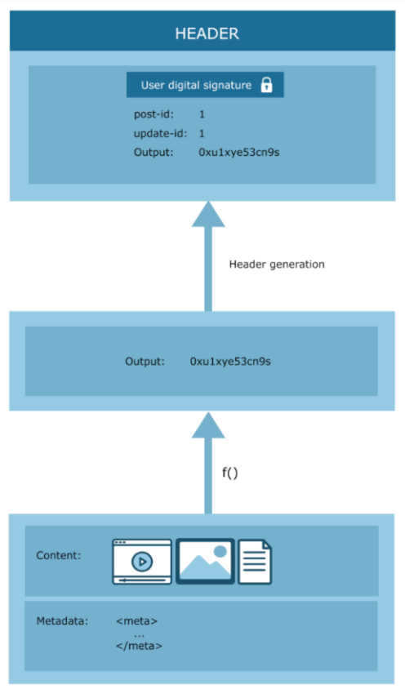
Content headers
Content headers solve inconsistency and impersonation

Slide 23
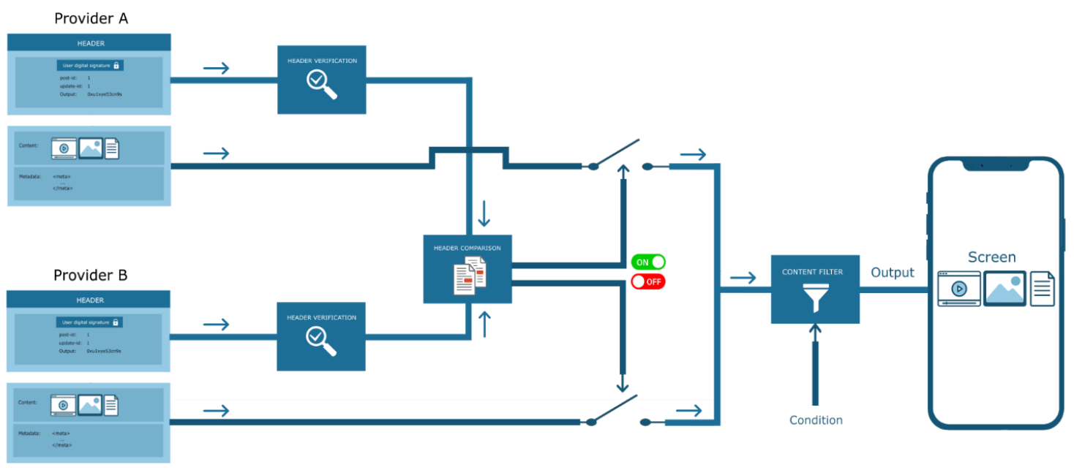
Content headers II
1. Anti-impersonation
2. Without inconsistencies
3. Censorship resistant
4. Content security

Slide 24
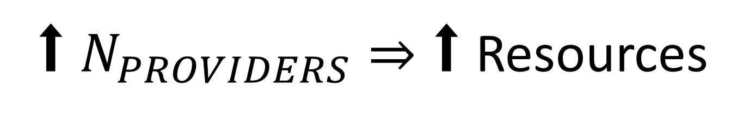
⬆ $N_{PROVIDERS}⇒$ $\text{⬆}$Resources

Slide 25
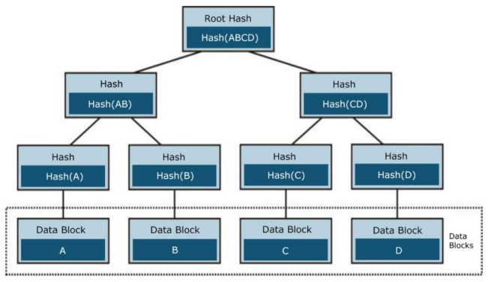
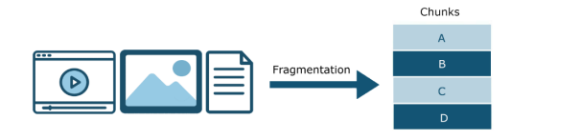
Proof of Storage I

Slide 26
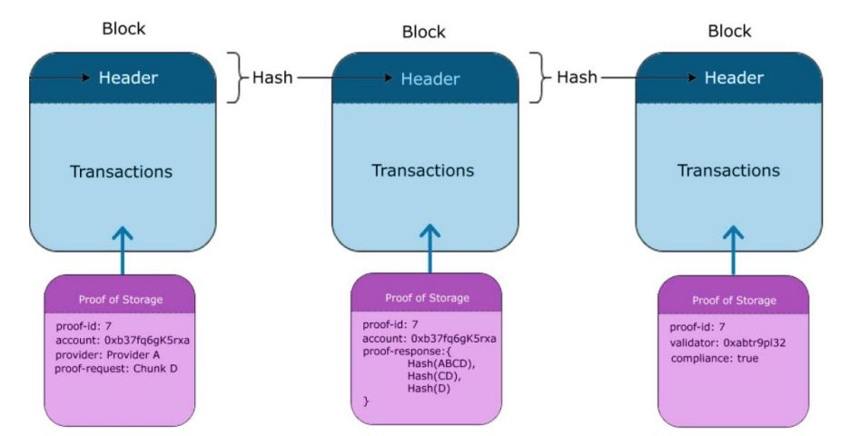
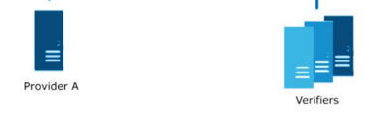
Proof of Storage II

Slide 27

5. Development of a decentralized social media

Slide 28
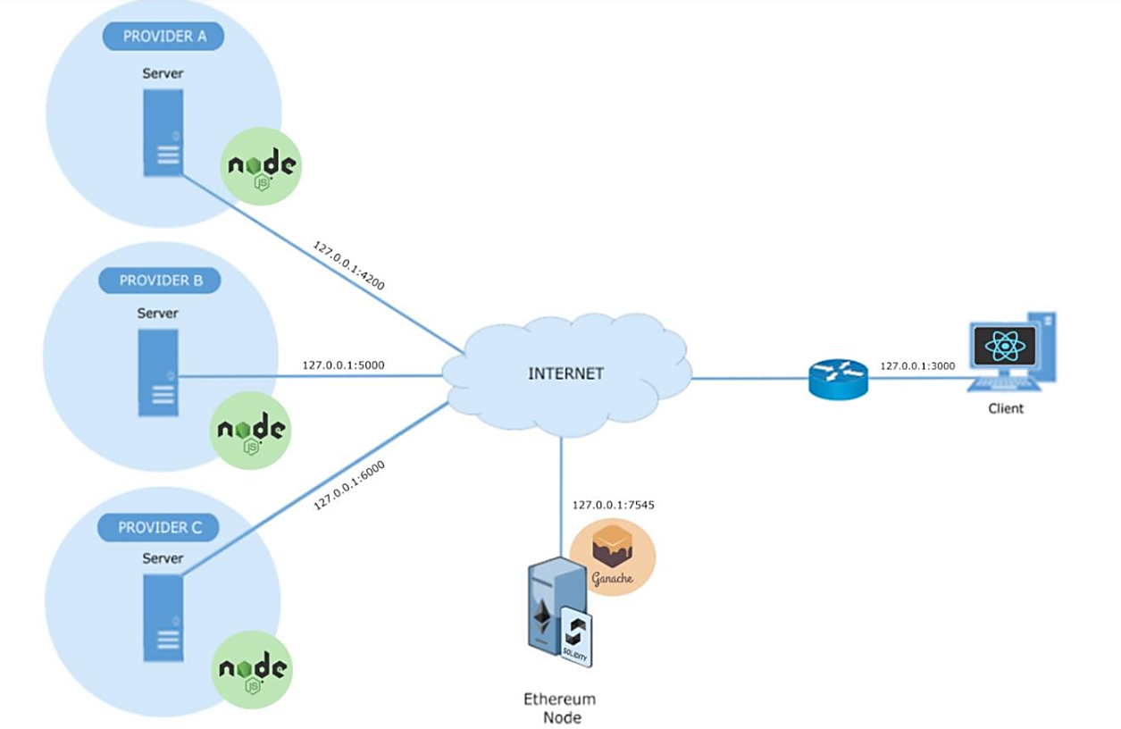

Slide 29
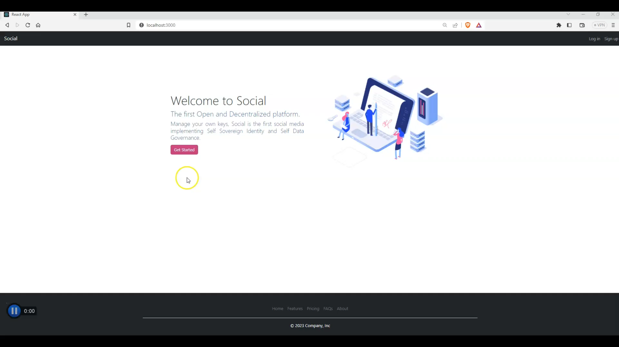

Slide 30

6. Conclusions and results

Slide 31
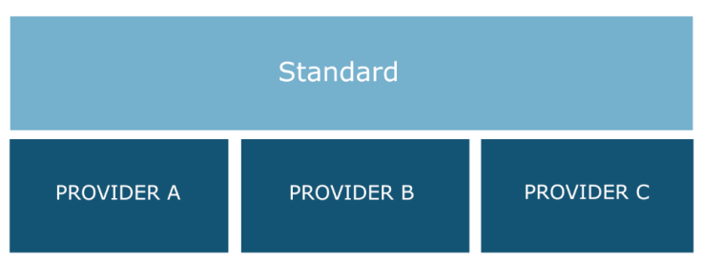

Slide 32
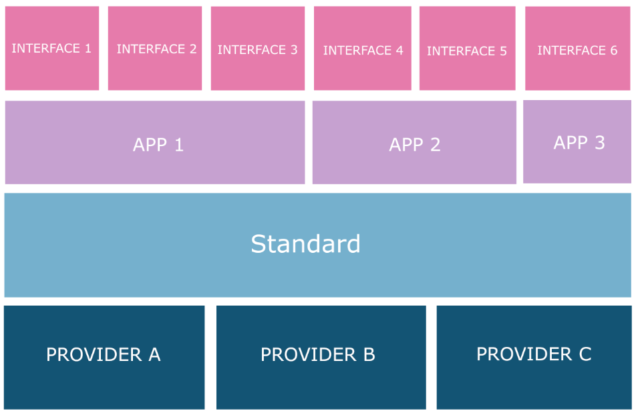

Slide 34

7. Future lines

Slide 35
Thank you
For Your Attention

